Slide 1

Emotion Analysis of Tweet
D. DURGA PRASAD PARDHU GUTTULA
TANGELLAPALLI RAMYA MANASA VEMULAPALLI BAVYA SRI
THOTE PRASANTH PITANI NIRANJAN SAI
01
1

Slide 2

Table of Contents
Abstract Introduction Flow Chart Polarities Progress Output Conclusion Bibliography
3
4
5
6
7
13
16
17
04
2

Slide 3


Abstract
In recent years, messages and social media has ended up being a very close representation of a person’s life and his mental state.
People are willing to share their thoughts, stories and their personal feelings, mental states, desires on social network sites, blogging platforms etc.
This is a huge stockpile of data about a person’s
behavior and can be used for detection of various emotion states.
Emotion Analysis, as the name suggests, it means to identify the view or emotion behind a situation.
That is done by analyzing expressed opinions, images, sentiments, and other activities.
03
3

Slide 4


Introduction
Emotion analysis of tweets used to identify information which helps in businesses to understand their customers emotion by monitoring online conversations.
As customers express their reviews and thoughts about the brand more openly than ever before, this emotion analysis has become a powerful tool to monitor and understand online conversations. Analyzing customer feedback and reviews automatically through survey responses or social media discussions allows you to learn what makes your customer happy or disappointed.
Recent advancements in machine learning and deep learning have increased the efficiency of emotion analysis of tweets using machine learning algorithms.
04
4

Slide 5







Flowchart
Pre-processing Steps:
Filtering
Tokenization
Removal of Stop words
Tweets Data
Data Streaming
Tweet classified as positive, negative or neutral
Finding best model fit
Applying desired classification algorithm to classify the tweets
05
5

Slide 6







08
6

Slide 7
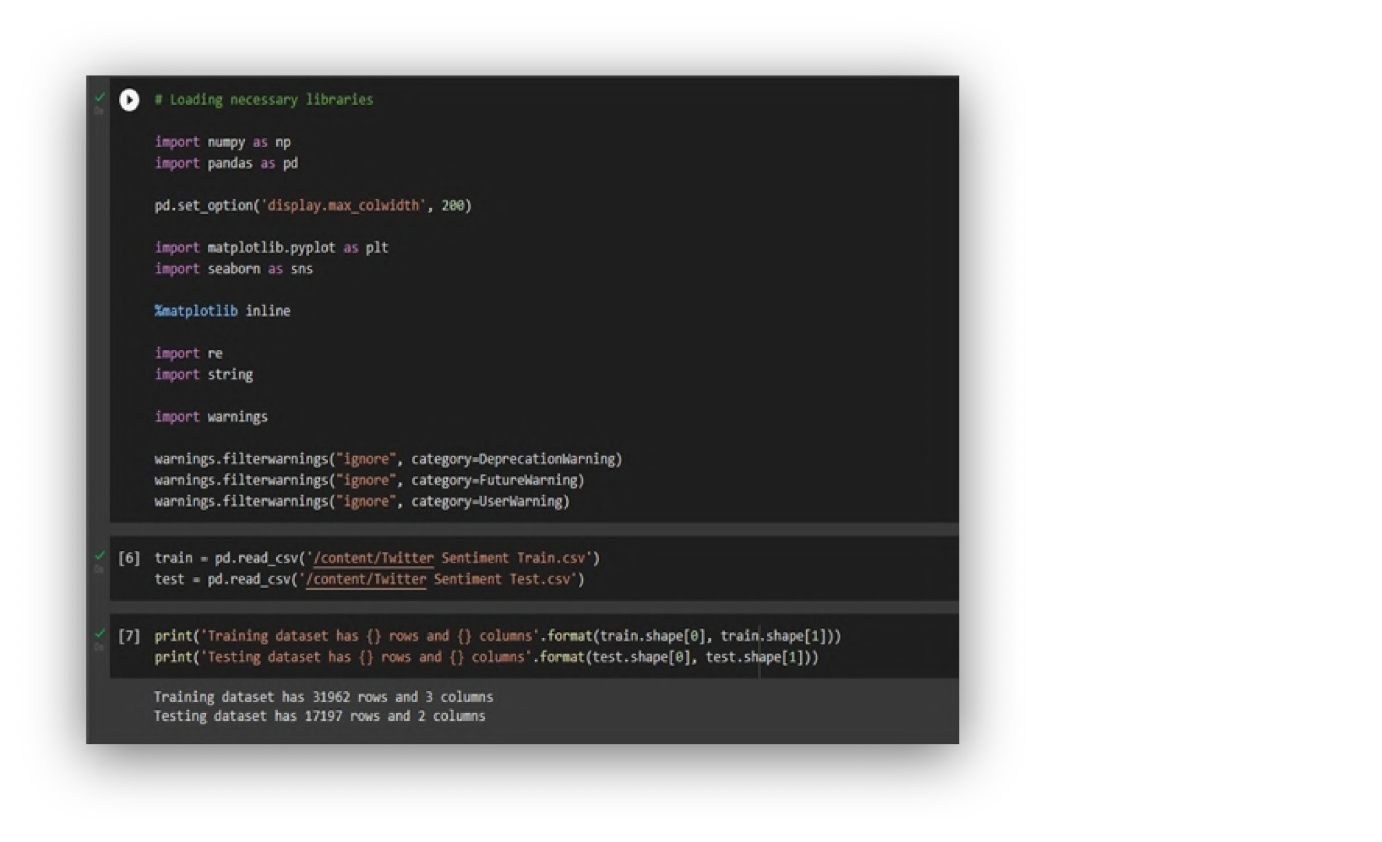
Progress
Analyze the datasets by importing necessary libraries.
07
7

Slide 8
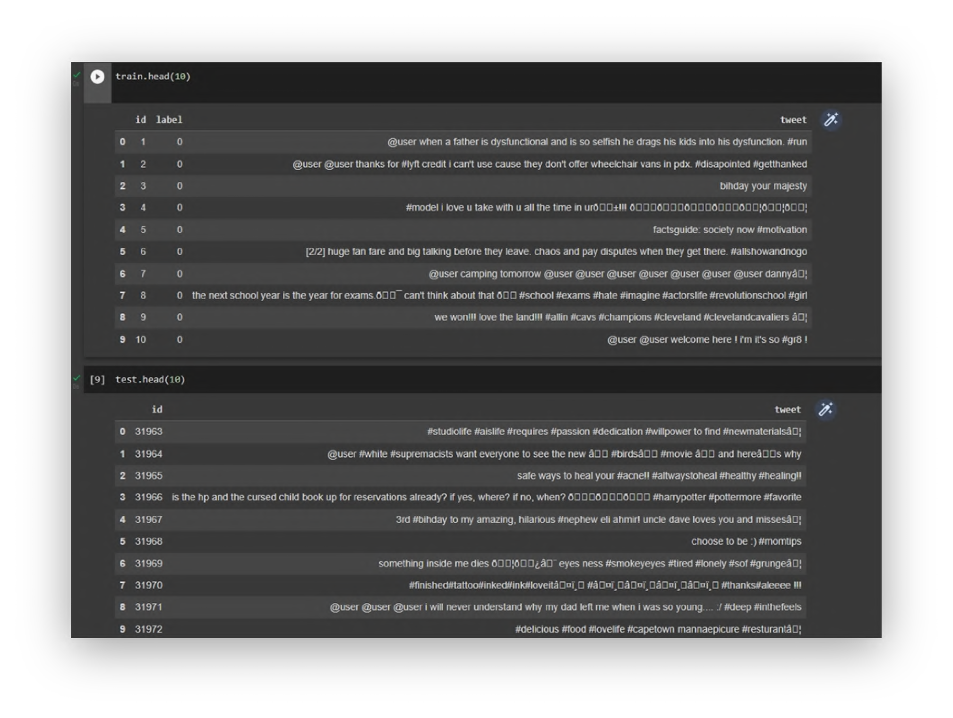
First ten rows from taken datasets

Slide 9
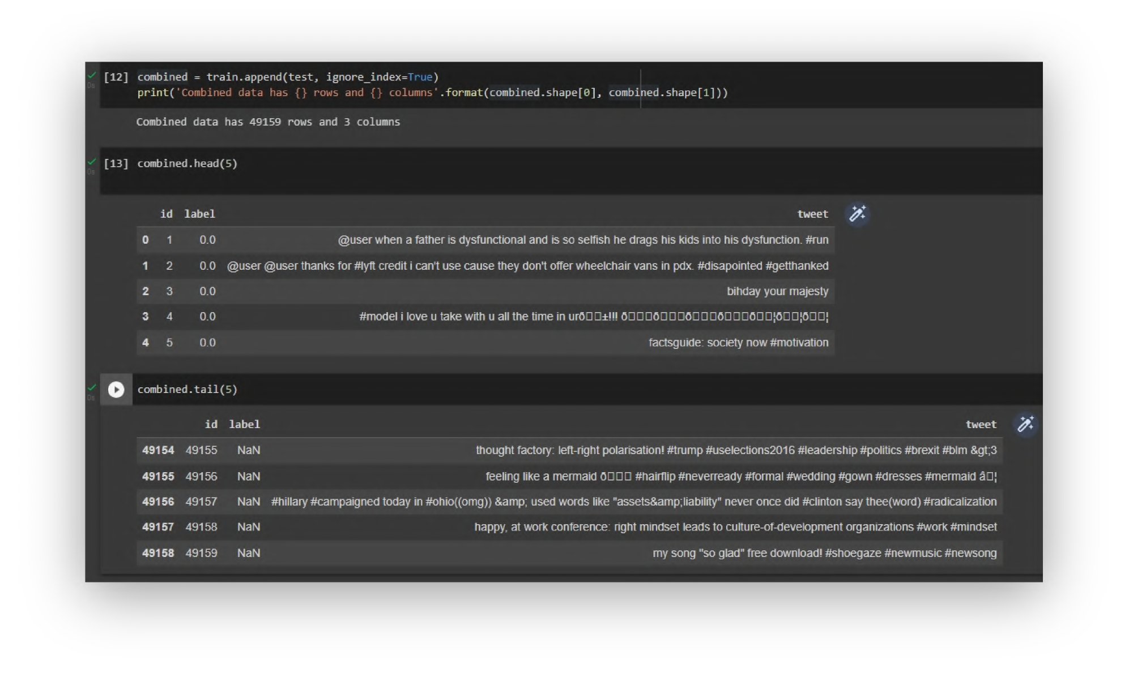
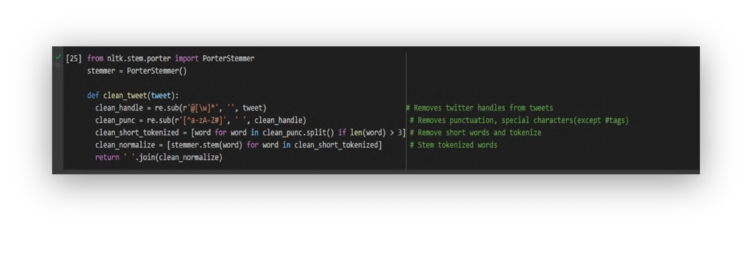

The implementation of PorterStemmer and creating a function to read and to remove twitter handles, punctuation, short words and stopwords.

Slide 10
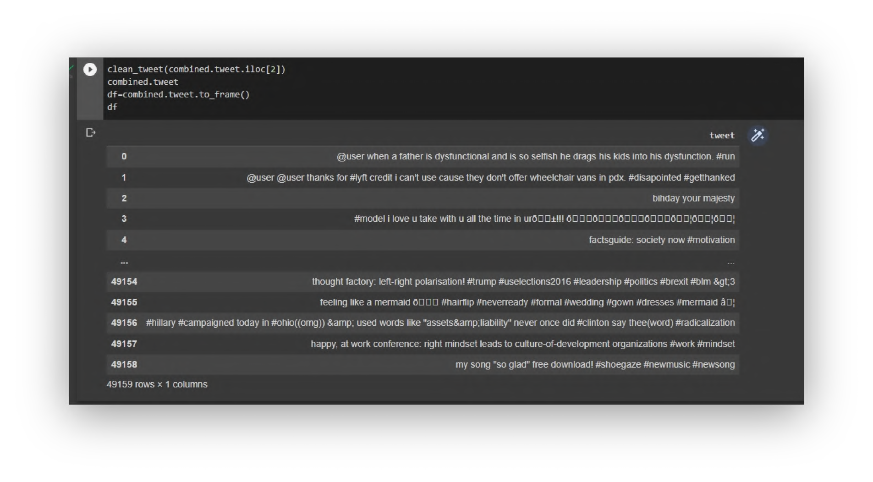
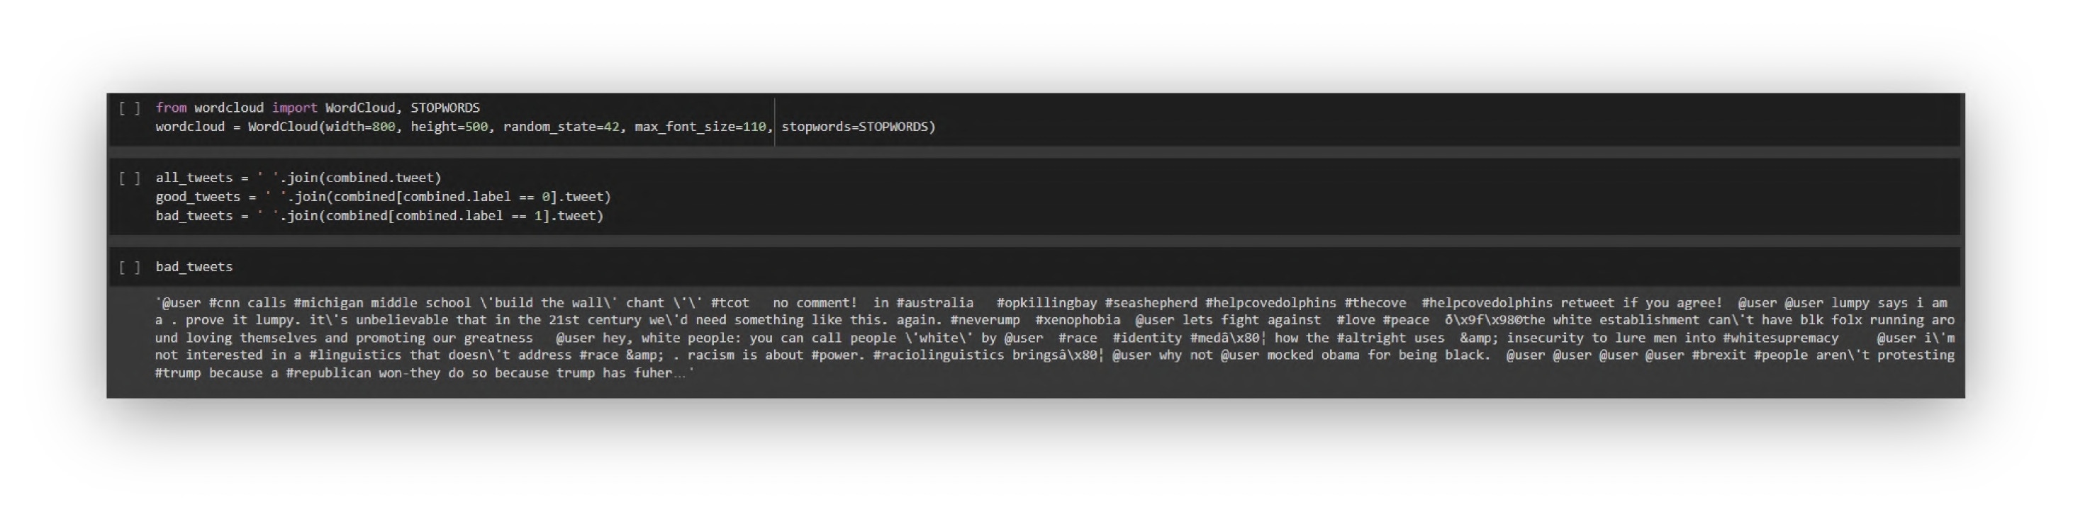
Conversion of combined tweets into dataframe
Creation of word cloud to generate an image of most representative words

Slide 11
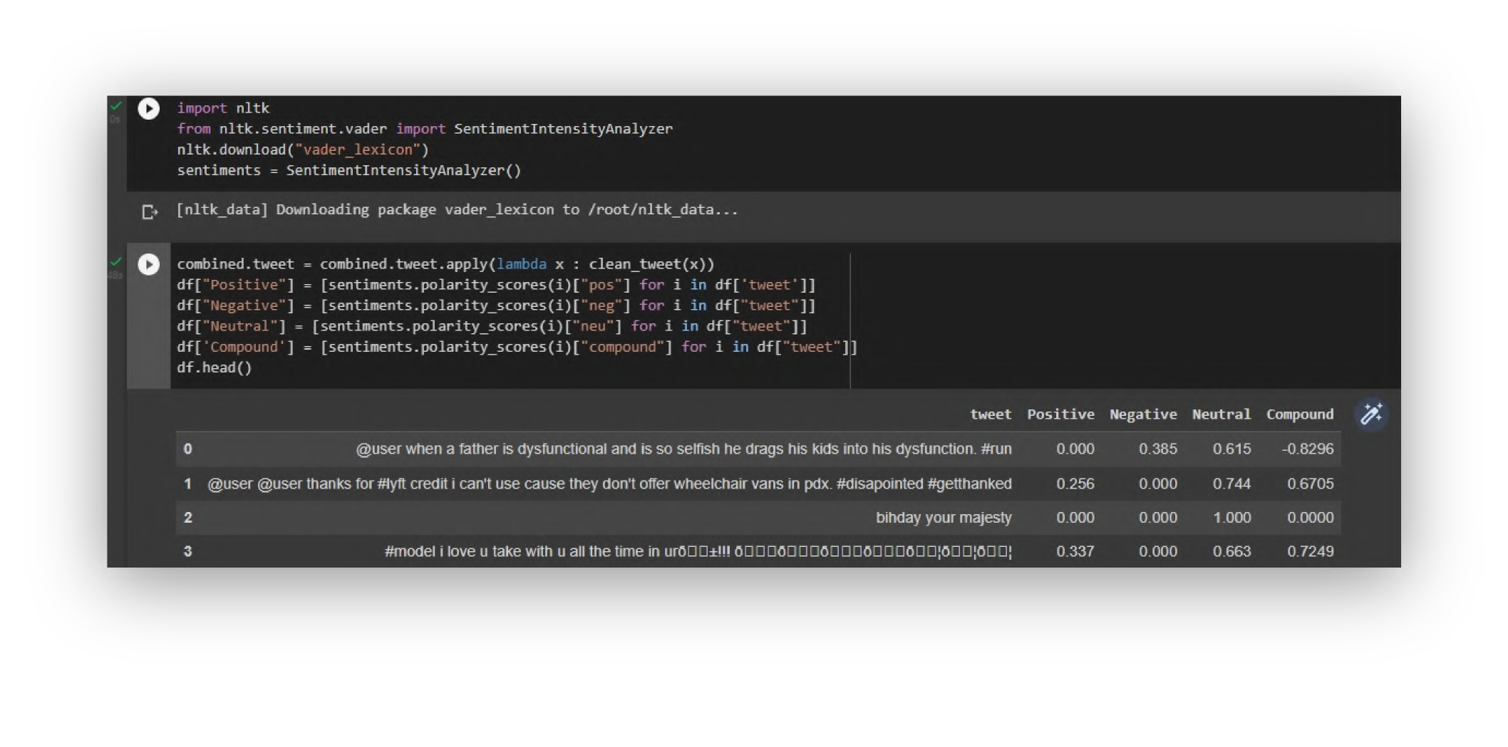
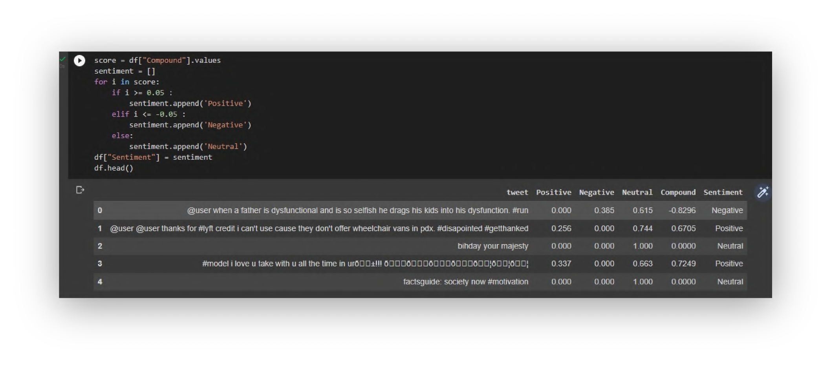
The code for adding 4 columns of positive, negative, neutral and compound to the dataset.
Classification of emotion of tweets by comparing compound score.

Slide 12
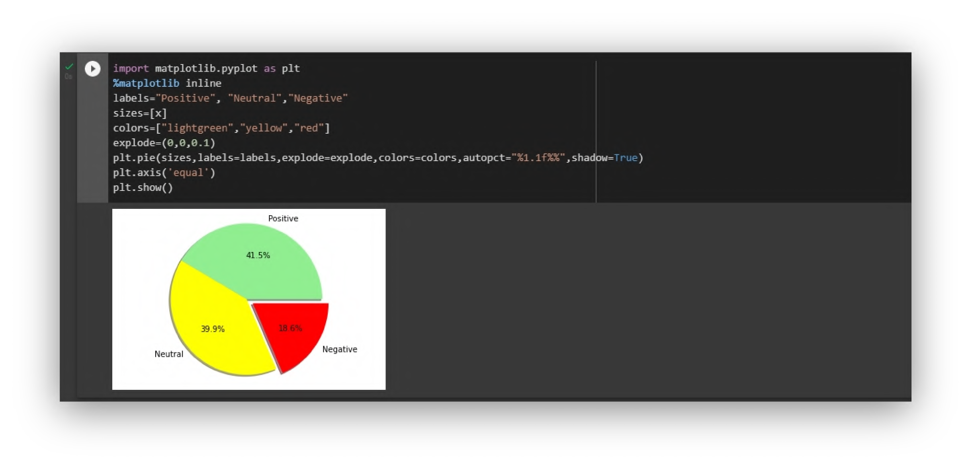
Frequencies of all labels.
Number of positive, negative, neutral tweets present in the given dataset.

Slide 13
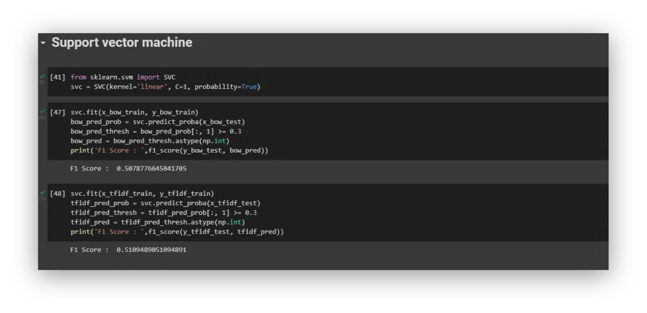
Output - Models Accuracy
The code for implementing SVM algorithm.

Slide 14
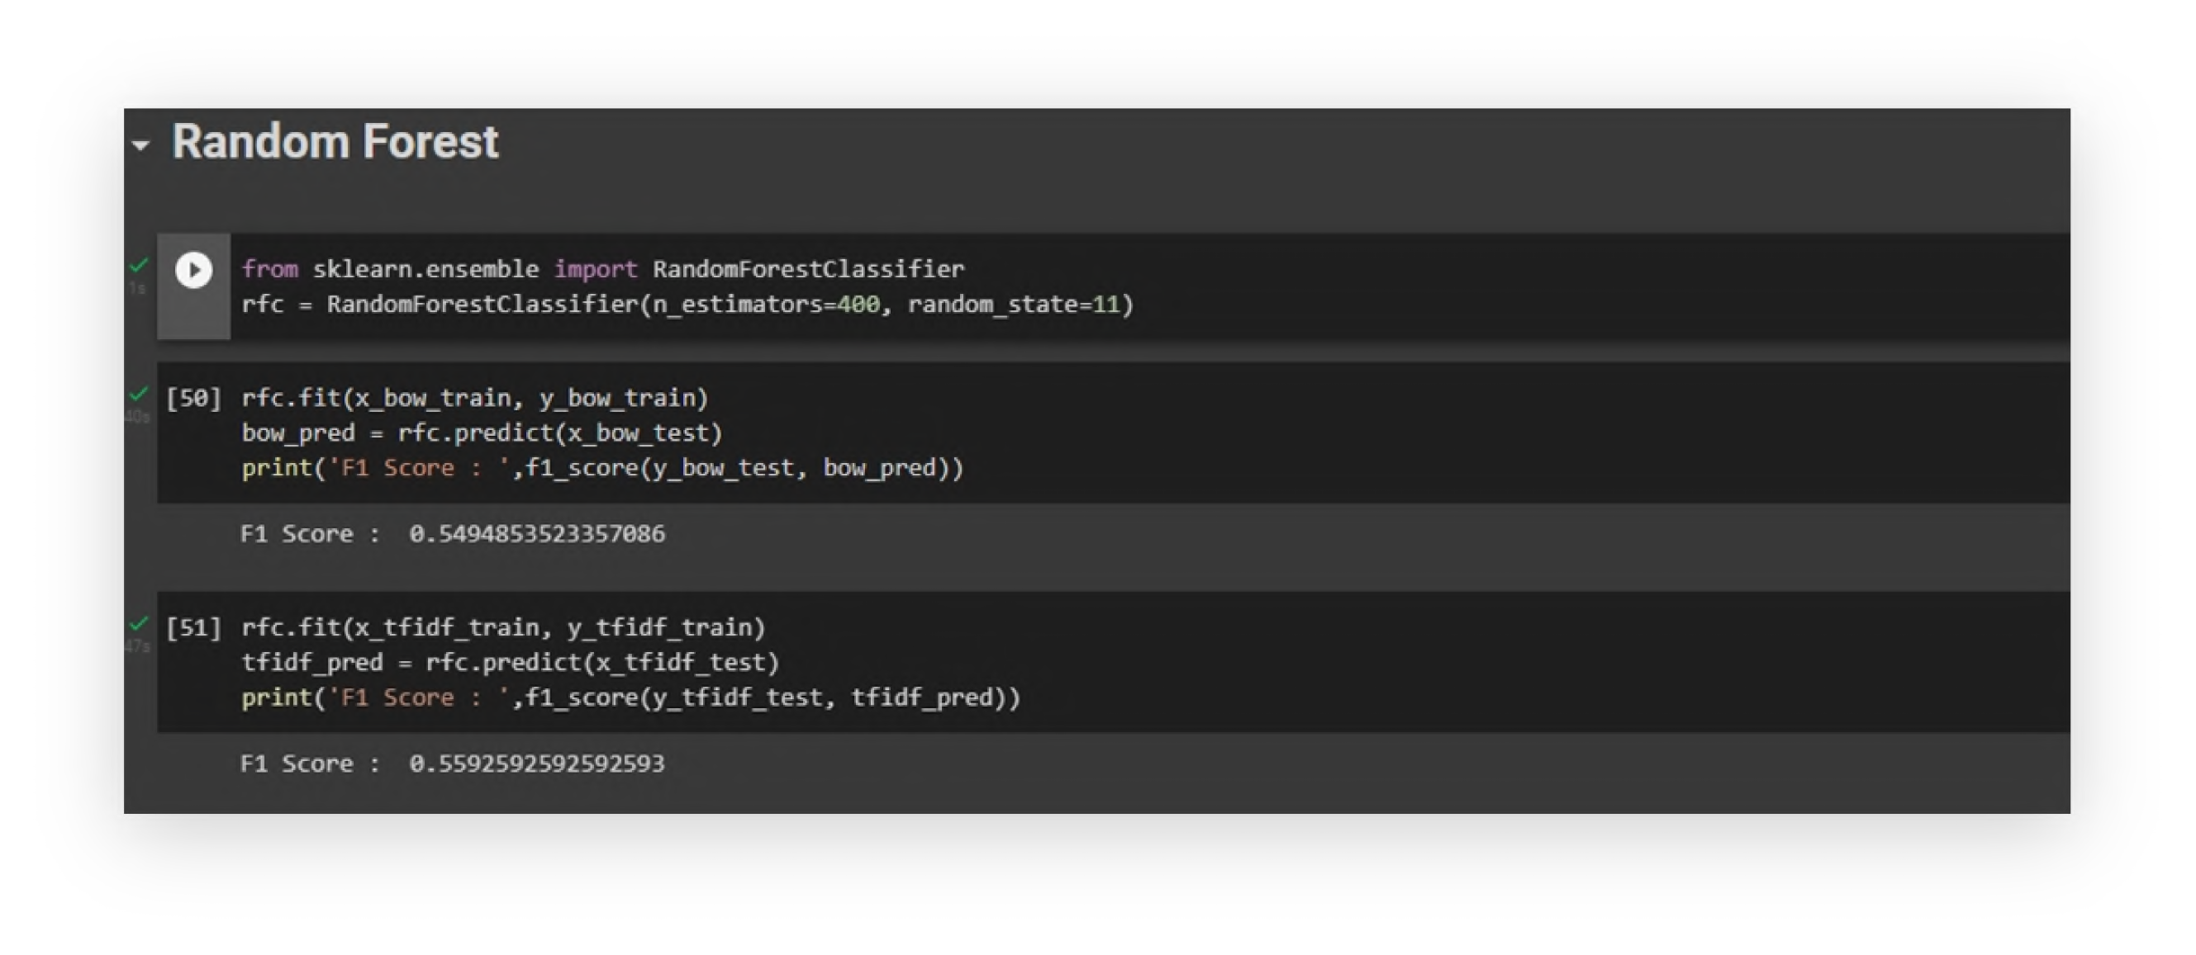
The code for Random Forest model and finding the F1 score of this model.
Code link: h ttps://colab.research.google.com/drive/1I3pZV4yoCgQZaNKa9HIsnZ18hAfzAeoF

Slide 15
Conclusion
We learned how to approach an emotion analysis problem by preprocessing and exploration of data. Then we extracted features from the cleaned text using Bag-of-Words and TF-IDF algorithms and predicted the emotion.
The best model fit is calculated by finding F1 score of these two models and based on the F1 scores we took maximum value of F1 score algorithm and we treat that algorithm as our main priority model.

Slide 16
References
Agarwal, B. Xie, I. Vovsha, O. Rambow, R. Passonneau, “Sentiment Analysis of Twitter Data", In Proceedings of the ACL 2011Workshop on Languages in Social Media,2011 , pp. 30-38
Pang, B.and Lee, L. “A sentimental education: Sentiment analysis using subjectivity summarization based on minimum cuts”. 42nd Meeting of the Association for Computational Linguistics[C] (ACL-04). 2004, 271-278.
Neethu M,S and Rajashree R,” Sentiment Analysis in Twitter using Machine Learning Techniques” 4th ICCCNT 2013,at Tiruchengode, India. IEEE – 31661
A. Pak,and P. Paroubek, “Twitter as a Corpus for Sentiment Analysis and Opinion Mining,” Special Issue of International Journal of Computer Application, France:Universitede Paris-Sud, 2010
Dasgupta, S. S., Natarajan, S., Kaipa, K. K., Bhattacherjee, S. K., & Viswanathan, A. (2015, October). Sentiment analysis of Facebook data using Hadoop based open source technologies. In Data Science and Advanced Analytics (DSAA), 2015. 36678 2015. IEEE International Conference on (pp. 1-3). IEEE.
12
16

Slide 17


12
17

